Slide 1
How to Access a Previous Course
Log in to Canvas and select the Courses tab on the garnet global navigation menu on the left of the screen.
Select the All Courses Link from the menu that appears.
On the All Courses page, scroll down to Past Enrollments. From here, you can access a previous course by selecting a hyperlinked course name.

Slide 2
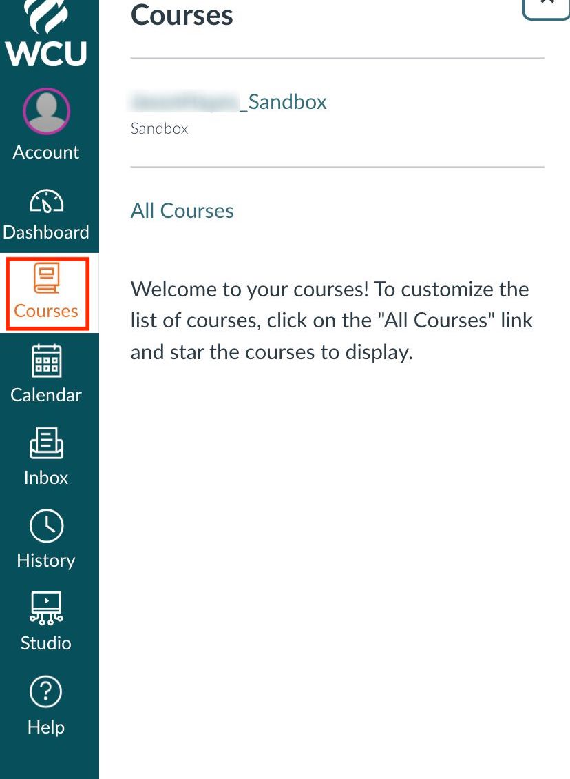
Step 1
Log in to Canvas and select the Courses tab on the garnet global navigation menu on the left of the screen.

Slide 3
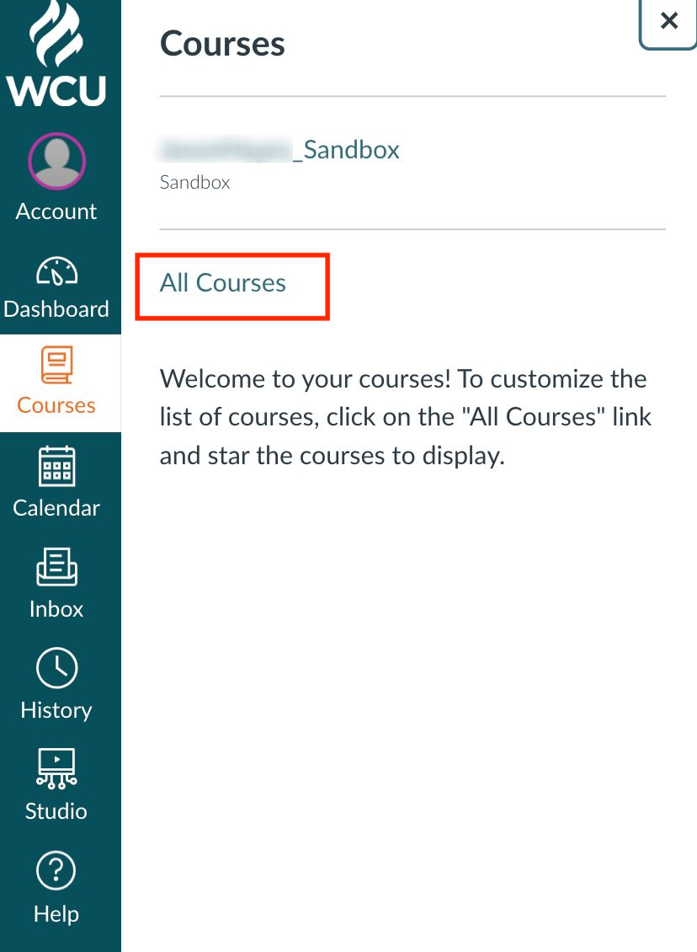
Step 2
Select the All Courses Link from the menu that appears.

Slide 4
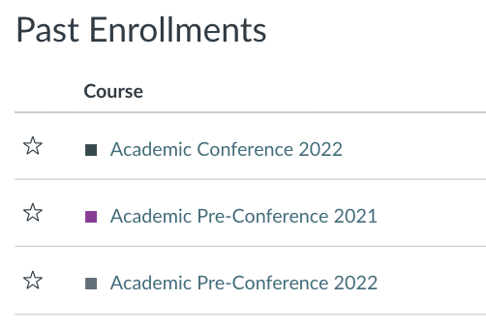
Step 3
On the All Courses page, scroll down to Past Enrollments. From here, you can access a previous course by selecting a hyperlinked course name.

